Slide 1


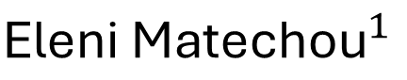

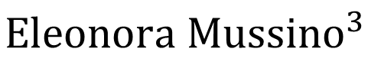
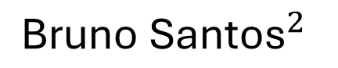
Estimating Population Size from Register Data: a Capture-Recapture Approach
${\text{Lucy} \text{Brown}}^{1}$: lyb3@kent.ac.uk
$${\text{Eleni} \text{Matechou}}^{1}$$
$${\text{Bruno} \text{Santos}}^{2}$$
$${\text{Eleonora} \text{Mussino}}^{3}$$
1 University of Kent, UK
2 University of Lisbon, Portugal
3 Stockholm University, Sweden

Slide 2
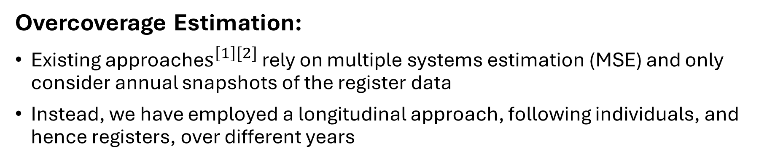
Motivating Case Study
[1] Andrea Monti, Sven Drefahl, Eleonora Mussino, and Juho Härkönen. Over-coverage in population registers leads to bias in demographic estimates. Population Studies, 74(3):451–469, 2020
[2] Eleonora Mussino, Bruno Santos, Andrea Monti, Eleni Matechou, and Sven Drefahl. Multiple systems estimation for studying over-coverage and its heterogeneity in population registers. Quality & Quantity, pages 1–24, 2023
Overcoverage:
Due to imperfect emigration and/or death registration
Leads to serious bias in population estimates
Negatively influences policy-making and research
Overcoverage Estimation:
Existing approache$s^{\left[1\right][2]}$ rely on multiple systems estimation (MSE) and only consider annual snapshots of the register data
Instead, we have employed a longitudinal approach, following individuals, and hence registers, over different years

Slide 3
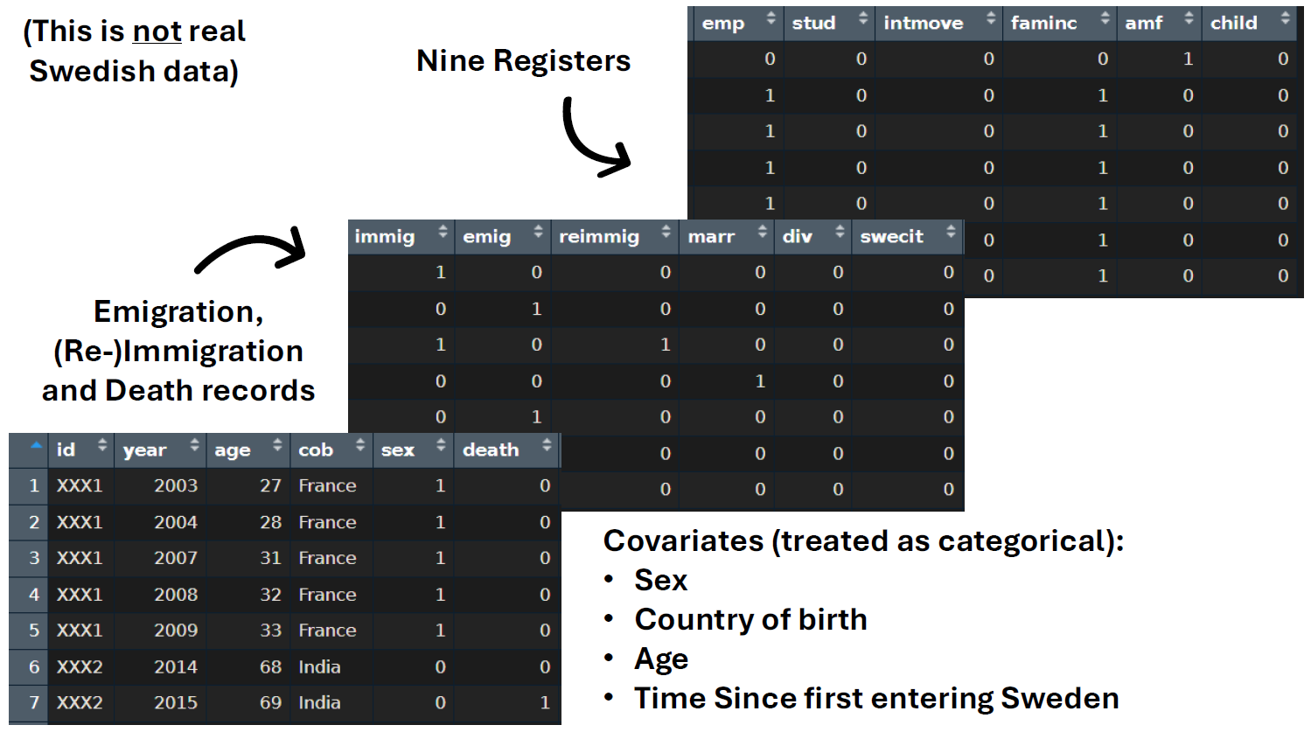
Swedish Register Data
Provided by the Swedish National Institute of Statistics (Statistics Sweden - SCB)
All foreign-born residents who first entered Sweden between the years 2003 and 2016 as adults
(This is not real data)

Slide 4
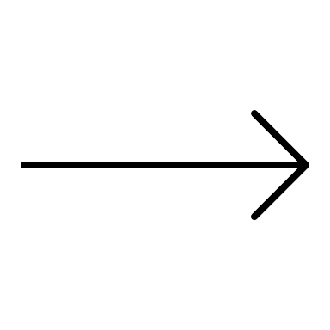
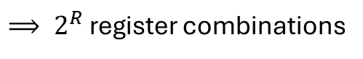
Observations
An individual is observed on some combination of R registers, on which they can be observed (1) or not observed (0), i.e. 2 possible outcomes for each register
$⟹ 2^{R}$ register combinations
Example Person #1
(0,1)
(1,1)
(0,0)
(0,0)
(0,0)
Death recorded
Dead
alive
alive
dead
dead
dead
Example Person #2
(1,1)
(0,1)
(0,0)
(0,0)
(1,0)
Have they been missed or are they not there anymore?
alive
alive
?
?
alive

Slide 5
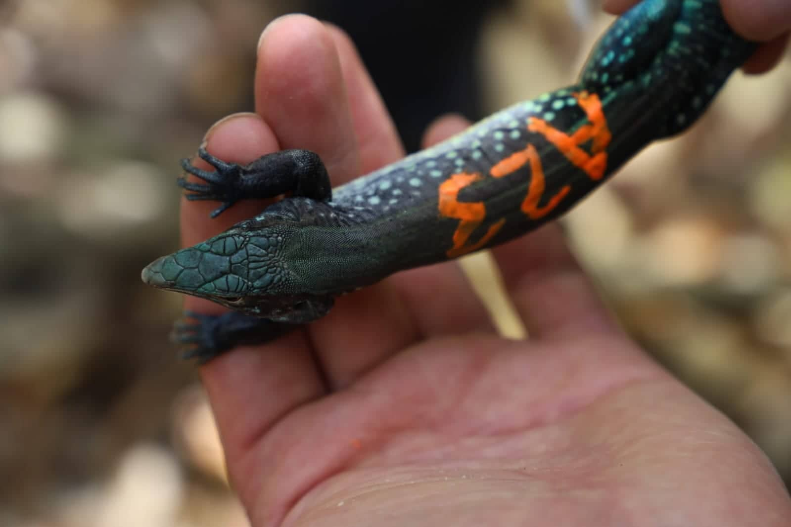

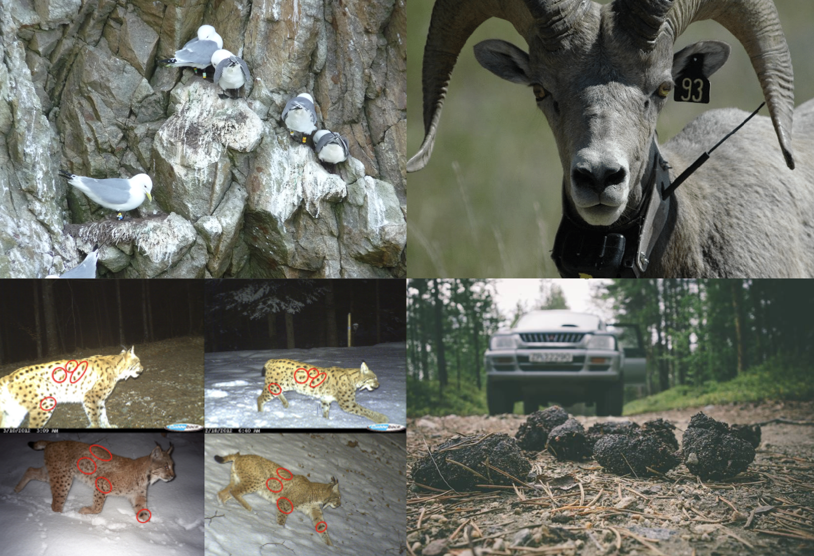
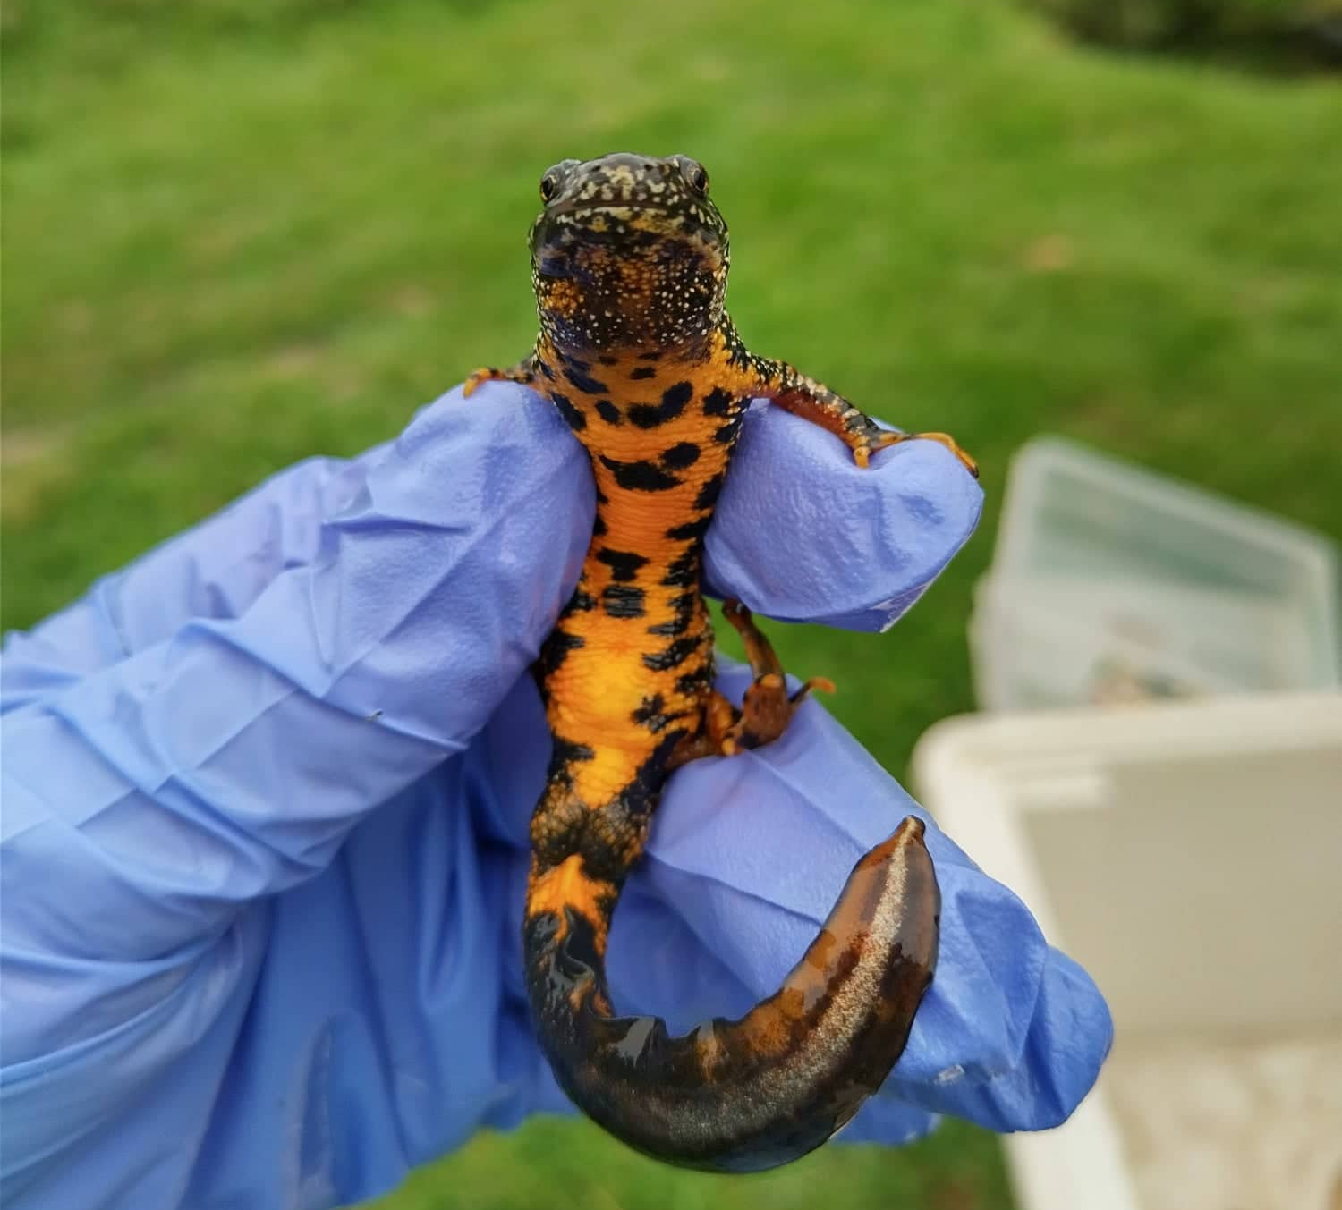
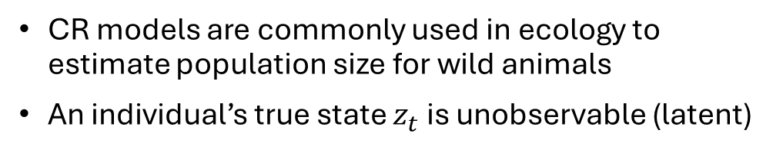
Capture-Recapture Models
Capture Recapture (CR) Models:
An initial capture is made
Unmarked individuals are marked in some unique way (tags, rings etc)
Individuals are released back into the population
Subsequent captures are made, allowing individuals to be tracked over time
Not Observed
Observed
CR models are commonly used in ecology to estimate population size for wild animals
An individual’s true state $z_{t}$ is unobservable (latent)
Left the study area
Alive but missed
Dead
Alive
Kenneth H. Pollock. Capture-recapture models. Journal of the American Statistical Association, 95(449):293–296, 2000. ISSN 01621459, 1537274X. URLhttp://www.jstor.org/stable/2669550

Slide 6
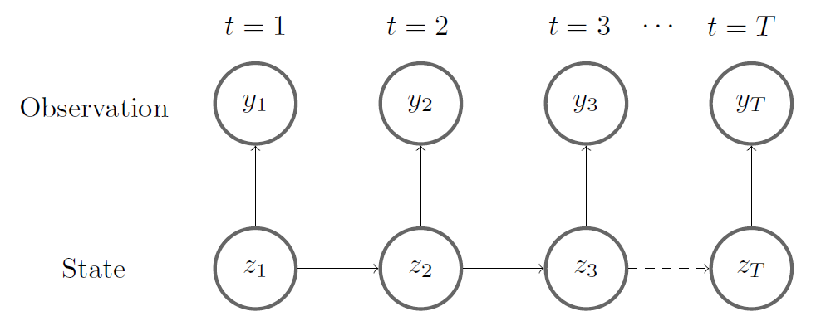
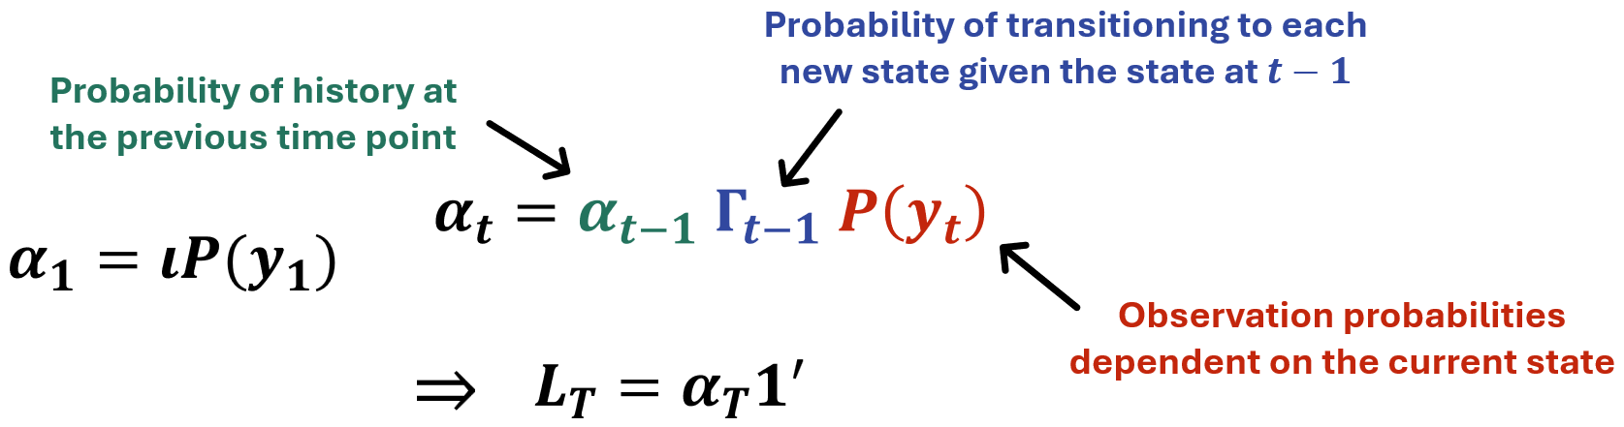
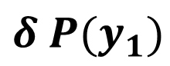
HMM Formulation
J. L. Laake. Capture-recapture analysis with hidden markov models. 2013.
Hidden Markov model (HMM) formulation marginalises over the latent state to calculate the marginal likelihood
The marginal likelihood is the probability of the observed data and the latent states, given the model parameters
Computationally expensive so use the Forward Algorithm
This iterative method is very efficient and allows latent states to be inferred
$$δ P(y_{1})$$

Slide 7
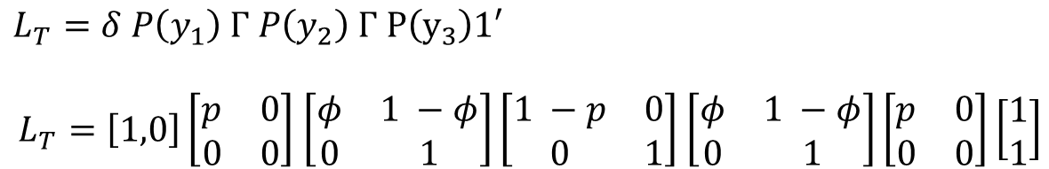
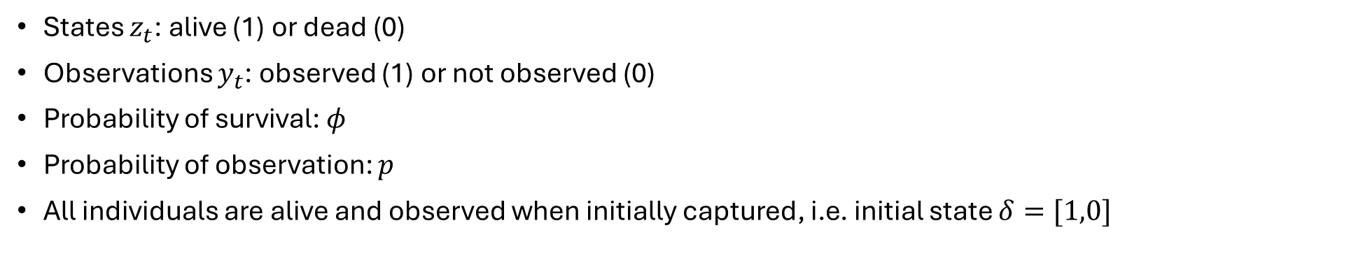
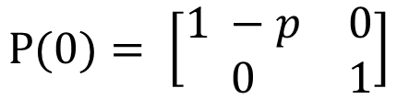
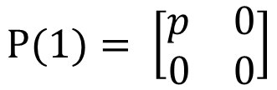
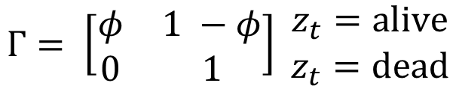
Simple CR Model
$$Γ= \left[\begin{matrix}φ & 1 −φ \\ 0 & 1\end{matrix}\right] \begin{matrix}z_{t}=alive \\ z_{t}=dead\end{matrix}$$
States $z_{t}$: alive (1) or dead (0)
Observations $y_{t}$: observed (1) or not observed (0)
Probability of survival: $φ$
Probability of observation: $p$
All individuals are alive and observed when initially captured, i.e. initial state $δ=[1,0]$
$$P(0)= \left[\begin{matrix}1 −p & 0 \\ 0 & 1\end{matrix}\right]$$
$$P(1)= \left[\begin{matrix}p & 0 \\ 0 & 0\end{matrix}\right]$$
If an individual has capture history $y_{t}=[1,0,1]$, they have a likelihood:
$L_{T}=δ P\left(y_{1}\right) Γ P\left(y_{2}\right) Γ P\left(y_{3}\right)1′$
$L_{T}=\left[1,0\right]\left[\begin{matrix}p & 0 \\ 0 & 0\end{matrix}\right]$ $\left[\begin{matrix}φ & 1 −φ \\ 0 & 1\end{matrix}\right]\left[\begin{matrix}1 −p & 0 \\ 0 & 1\end{matrix}\right]$ $\left[\begin{matrix}φ & 1 −φ \\ 0 & 1\end{matrix}\right]\left[\begin{matrix}p & 0 \\ 0 & 0\end{matrix}\right]\left[\begin{matrix}1 \\ 1\end{matrix}\right]$

Slide 8
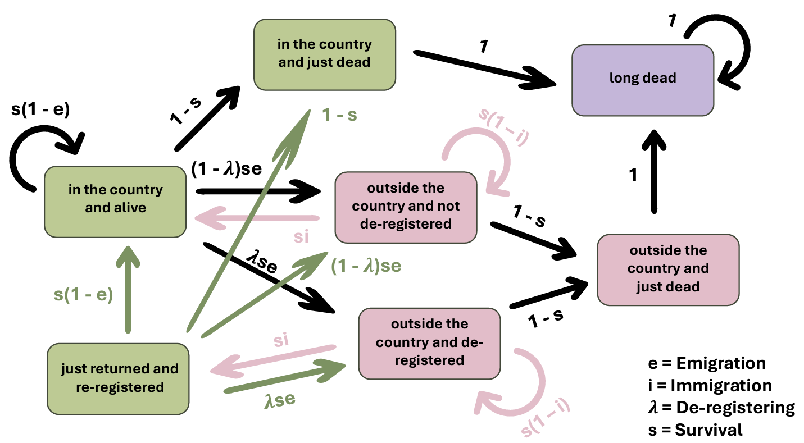
States

Slide 9
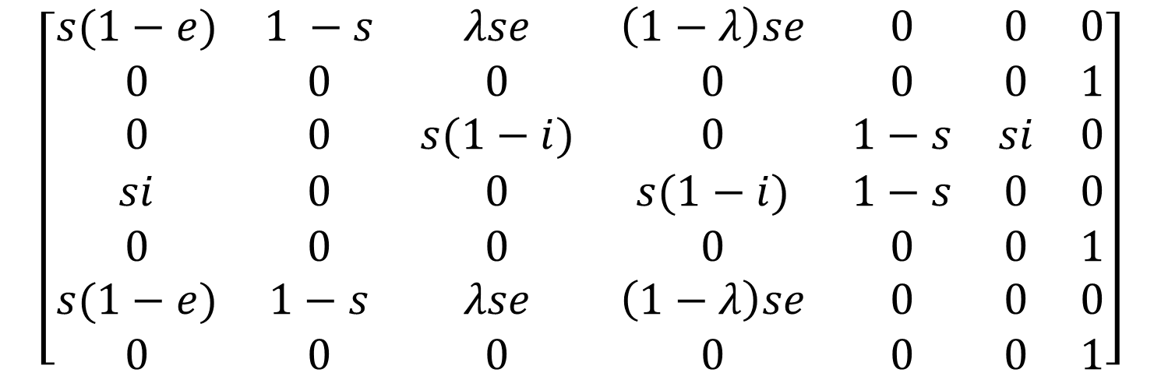
Transition Matrix
$$\left[\begin{matrix}s(1−e) & 1 −s & λse & \left(1−λ\right)se & 0 & 0 & 0 \\ 0 & 0 & 0 & 0 & 0 & 0 & 1 \\ 0 & 0 & s(1−i) & 0 & 1−s & si & 0 \\ si & 0 & 0 & s(1−i) & 1−s & 0 & 0 \\ 0 & 0 & 0 & 0 & 0 & 0 & 1 \\ s(1−e) & 1−s & λse & \left(1−λ\right)se & 0 & 0 & 0 \\ 0 & 0 & 0 & 0 & 0 & 0 & 1\end{matrix}\right]$$
In the country and alive
In the country and just dead
Outside the country and de-registered
Outside the country but didn’t de-register
5. Outside the country and just dead
6. Just returned to the country having de-registered
7. Long dead

Slide 10



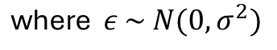
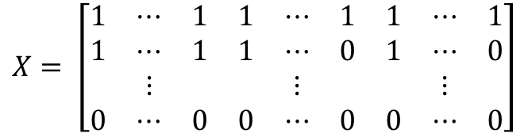
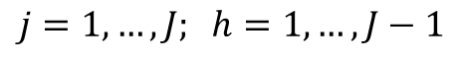
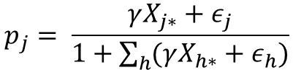

Model Coefficients Specification
Parameters in the transition matrix are specified using logistic regression:
$logit\left(θ\right)=β_{0}+β_{1}C_{1}+β_{2}C_{2}+ …+ε$ where $ε \sim N(0, σ^{2})$
Individual- and time-dependent covariates C
Random effects
Parameters in the observation matrix are specified using multinomial regressio$n^{[4]}$:
$$X= \left[\begin{matrix}1 & ⋯ & 1 & 1 & ⋯ & 1 & 1 & ⋯ & 1 \\ 1 & ⋯ & 1 & 1 & ⋯ & 0 & 1 & ⋯ & 0 \\ & ⋮ & & & ⋮ & & & ⋮ & \\ 0 & ⋯ & 0 & 0 & ⋯ & 0 & 0 & ⋯ & 0\end{matrix}\right]$$
$$p_{j}= \frac{γX_{j∗}+ε_{j}}{1+\sum_{h}{(γX_{h∗}}+ε_{h})}$$
$$\text{where} ε \sim N(0, σ^{2})$$
$$j=1, …, J; h=1, …, J−1$$
Registers
Covariates
Interactions
where $p_{j}$ are the observation probabilities of each register combination
[4] A. Agresti. An introduction to categorical data analysis. John Wiley & Sons, 2nd edition, 2007.

Slide 11
Results

Slide 12
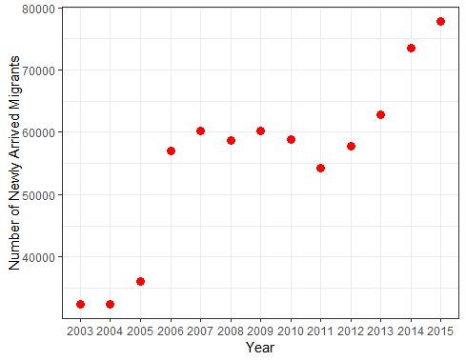
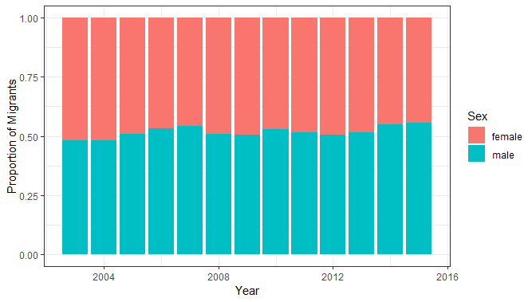
Distribution of sex for newly arrived migrants
Number of newly arrived migrants

Slide 13
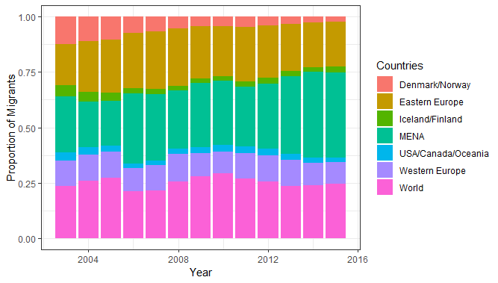
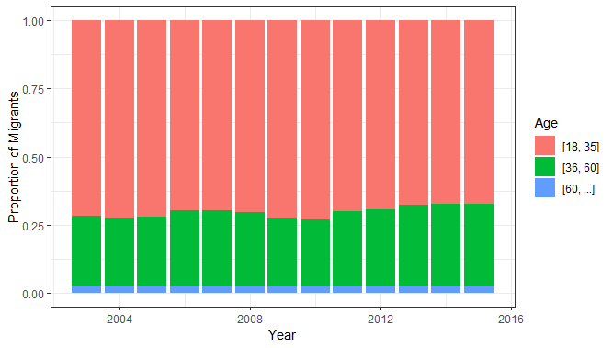
Distribution of age for newly arrived migrants
Distribution of country of birth for newly arrived migrants

Slide 14
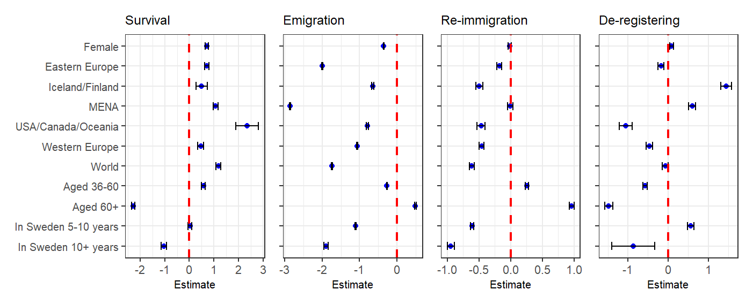
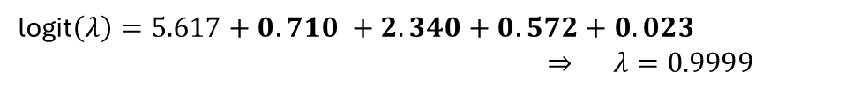
Survival Probability
Baseline: men aged 18-35, born in Denmark/Norway who first entered Sweden less than 5 years ago
logit$\left(λ\right)=5. 617 ⇒ λ=0.996$
Women aged 36-60, born in USA/Canada/Oceania who first entered Sweden 5-10 years ago
logit$\left(λ\right)=5.617+0.710 +2.340+0.572+0.023$
$⇒ λ=0.9999$
Men aged 60+, born in Denmark/Norway who first entered Sweden 10+ years ago
logit$\left(λ\right)=5.617 −2.272 −1.028$
$⇒ λ=0.910$

Slide 15
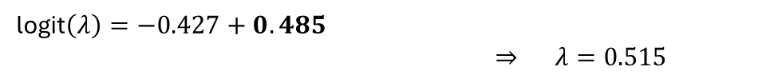
Emigration Probability
Baseline: men aged 18-35, born in Denmark/Norway who first entered Sweden less than 5 years ago
logit$\left(λ\right)=−0.427 ⇒ λ=0.395$
Men aged 60+, born in Denmark/Norway who first entered Sweden less than 5 years ago
logit$\left(λ\right)=−0.427+0.485$
$⇒ λ=0.515$
Women aged 36-60, born in MENA who first entered Sweden 10+ years ago
logit$\left(λ\right)=−0.427 −0.356 −2.855 −0.273 −1.899$
$⇒ λ=0.00299$

Slide 16
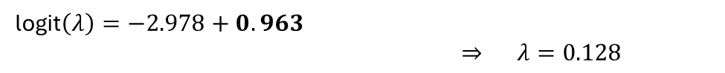
Re-Immigration Probability
Baseline: men aged 18-35, born in Denmark/Norway who first entered Sweden less than 5 years ago
logit$\left(λ\right)=−2.978 ⇒ λ=0.0532$
Men aged 60+, born in Denmark/Norway who first entered Sweden less than 5 years ago
logit$\left(λ\right)=−2.978+0.963$
$⇒ λ=0.128$
Women aged 18-35, born in the rest of the World who first entered Sweden 10+ years ago
logit$\left(λ\right)=−2.978−0.0159 −0.613 −0.946$
$⇒ λ=0.0115$

Slide 17
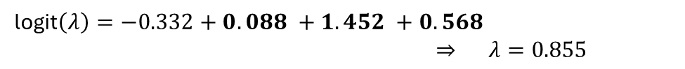
De-registering Probability
Baseline: men aged 18-35, born in Denmark/Norway who first entered Sweden less than 5 years ago
logit$\left(λ\right)=−0.332 ⇒ λ=0.418$
Women aged 18-35, born in Iceland/Finland who first entered Sweden 5-10 years ago
logit$\left(λ\right)=−0.332+0.088 +1.452 +0.568$
$⇒ λ=0.855$
Men aged 60+, born in USA/Canada/Oceania who first entered Sweden 10+ years ago
logit$\left(λ\right)=−0.332 −1.053 −1.474 −0.865$
$⇒ λ=0.024$
17

Slide 18
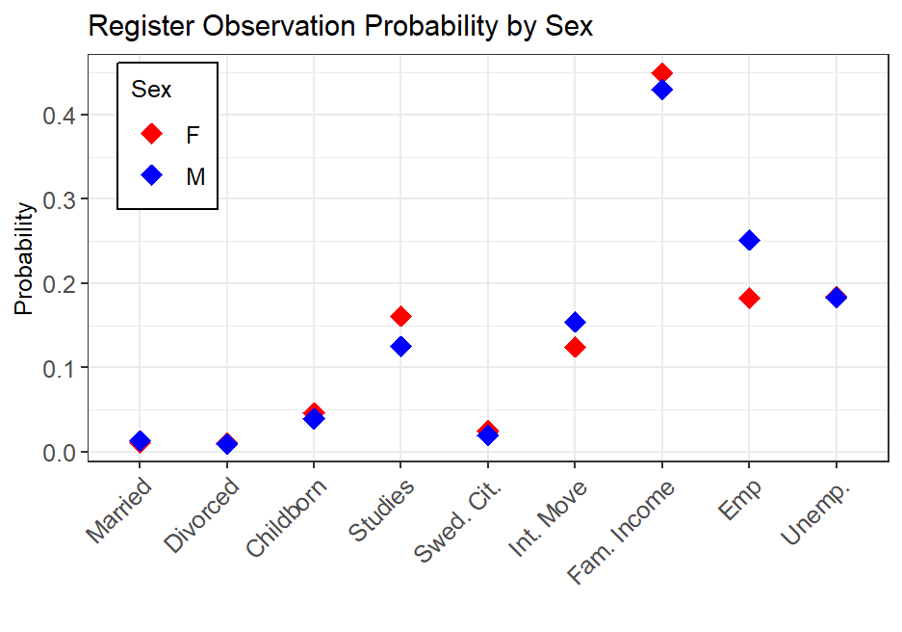

Slide 19

Register Combination Probabilities
Highest Probability Register Combinations | Male | Female
Family Income and Employment | 0.0965 | 0.0762
Family Income | 0.0368 | 0.0611
Family Income and Active Unemployment | 0.0305 | 0.0388
Lowest Probability Register Combinations | Male | Female
All except Internal Move and Family Income | 3.6107 x 10^-12 | 2.3061 x 10^-12
All except Family Income | 6.2981 x 10^-12 | 2.3061 x 10^-12
All except Family Income and Active Unemployment | 1.0539 x 10^-11 | 6.1599 x 10^-12
Probability of being unobserved
Male: 0.0251
Female: 0.0220
Probability of being observed in at least one register
Male: 0.9749
Female: 0.9780

Slide 20

Future Work
Calculate population size estimates using the Viterbi Algorithm
Considering further extensions such as dependence between family units
Application to equivalent data from Norway, provided by Statistics Norway
Additional complexity that checks are regularly done and individuals manually removed if not present in the country

Slide 21
Thank you for your attention!
Email: lyb3@kent.ac.uk

